Slide 1
Week 11A
CPE 487 Digital System Design
Darian Muresan
dmuresan@stevens.edu
© 2020 Stevens Institute of Technology. All Rights Reserved.

Slide 2
Agenda
Submit Final Project Proposals / Descriptions
Presentation and Evaluation Dates
Debouncing Switches
2

Slide 3
Final Projects Description and Due Dates
Please send Title and Project Description to Prof. Kevin Lu and Prof. Darian Muresan
klu2@stevens.edu
dmuresan@stevens.edu
Need to decide on Project Due Dates and Presentations
3

Slide 4
Project Evaluation Criteria
In presentation and final report, highlight the learning milestones from the syllabus.
Extra credit if you develop external hardware, off the board.
A final presentation in front of the class.
Project will be evaluated by professors and peers
4

Slide 5
Project Evaluation Criteria
Final report and presentation should include:
Block diagrams
Schematics
Logic, workflow, timing, or any other diagrams that help describe the project.
Extra: Oscilloscope screenshots.
5

Slide 6
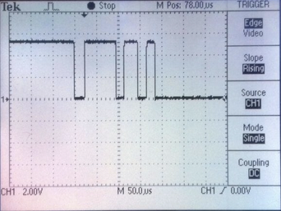
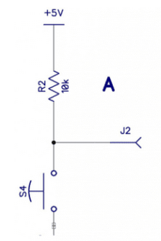
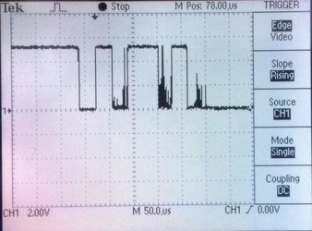
Switches in Digital Design
https://www.circuitbasics.com/switch-debouncing/

Slide 7
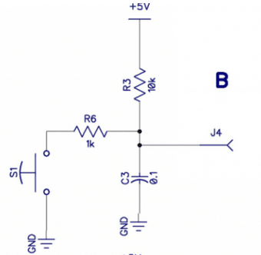
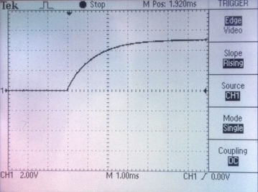
Debouncing a Switch
https://www.circuitbasics.com/switch-debouncing/

Slide 8
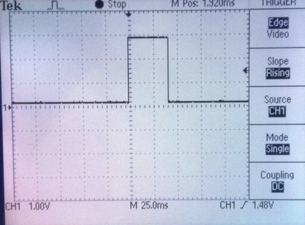
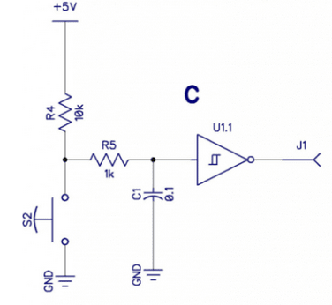
Debouncing a Switch With a Schmidt Trigger
https://www.circuitbasics.com/switch-debouncing/

Slide 9
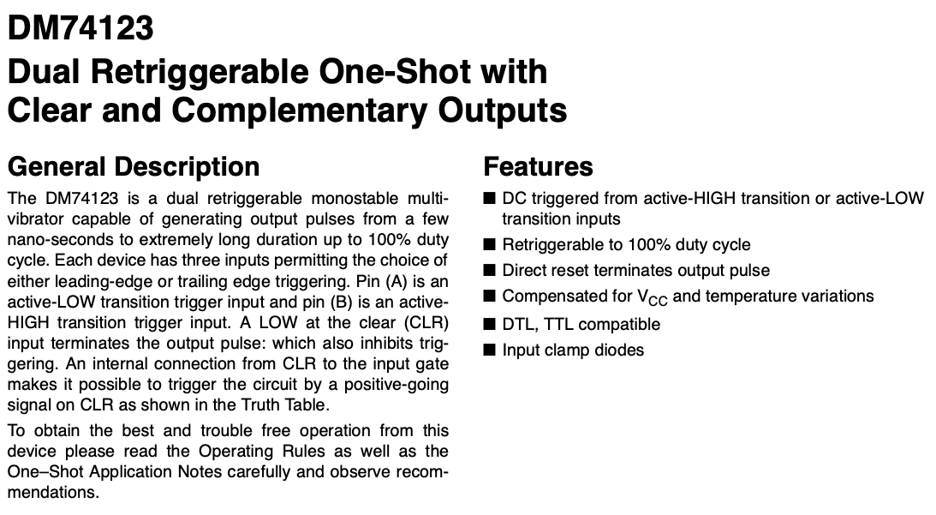
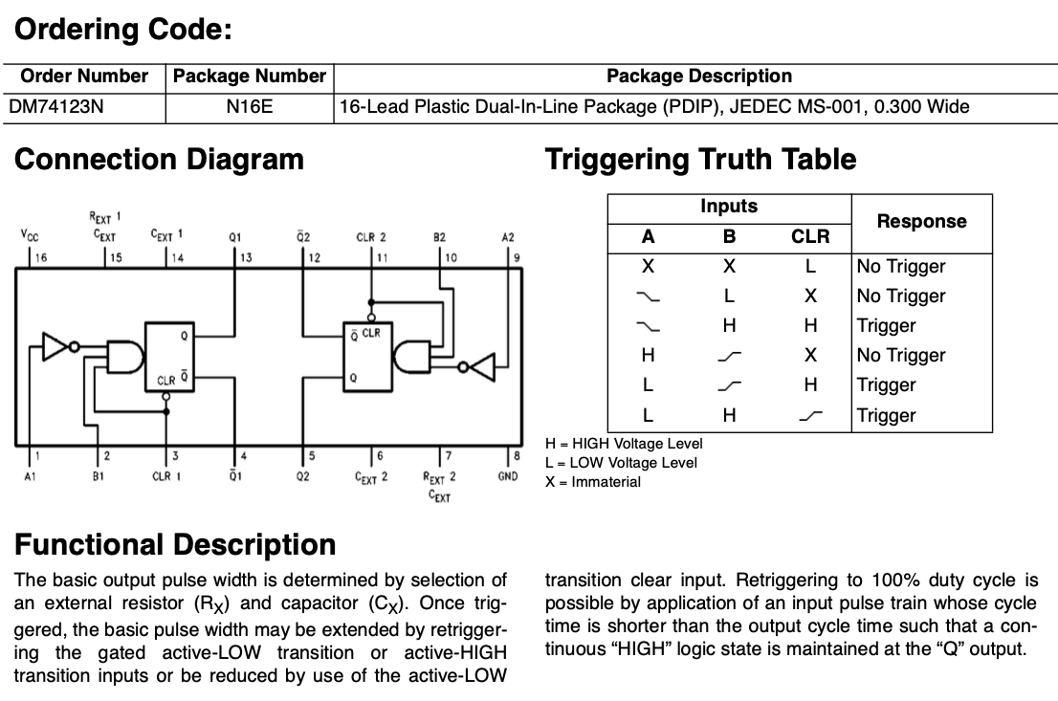
Debouncing a 74123 – One Shot Monostable

Slide 10
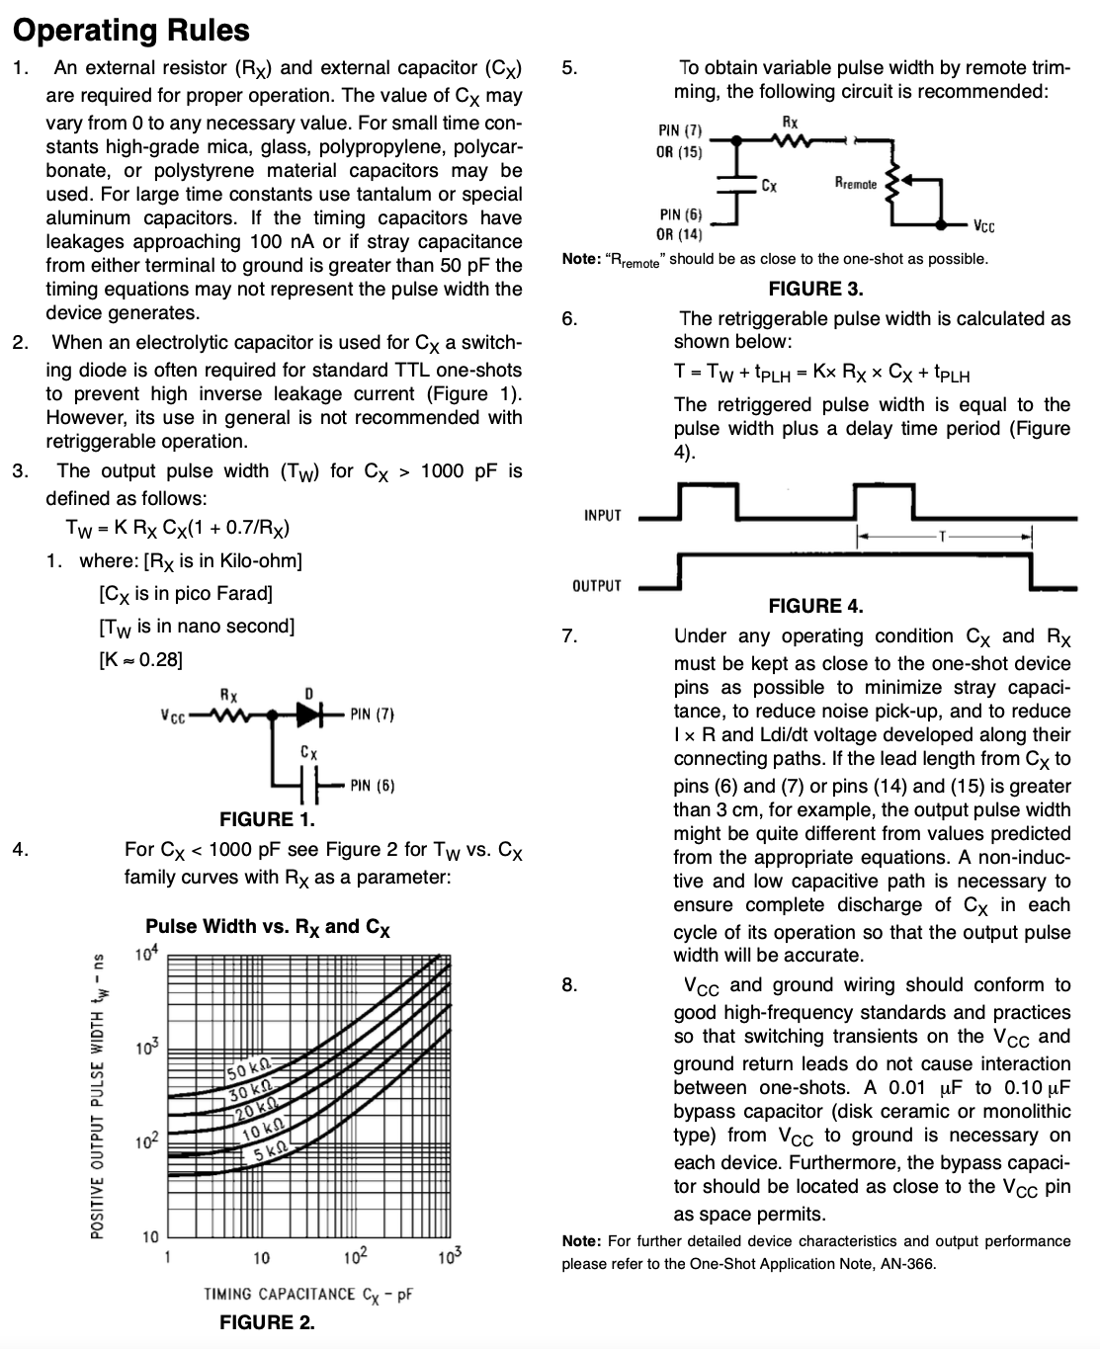
Debouncing 74123 – One Shot

Slide 11
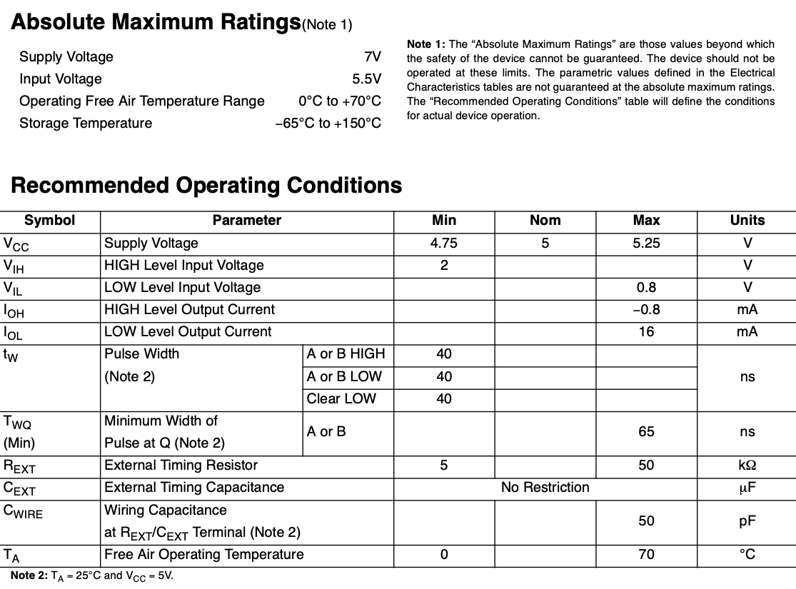
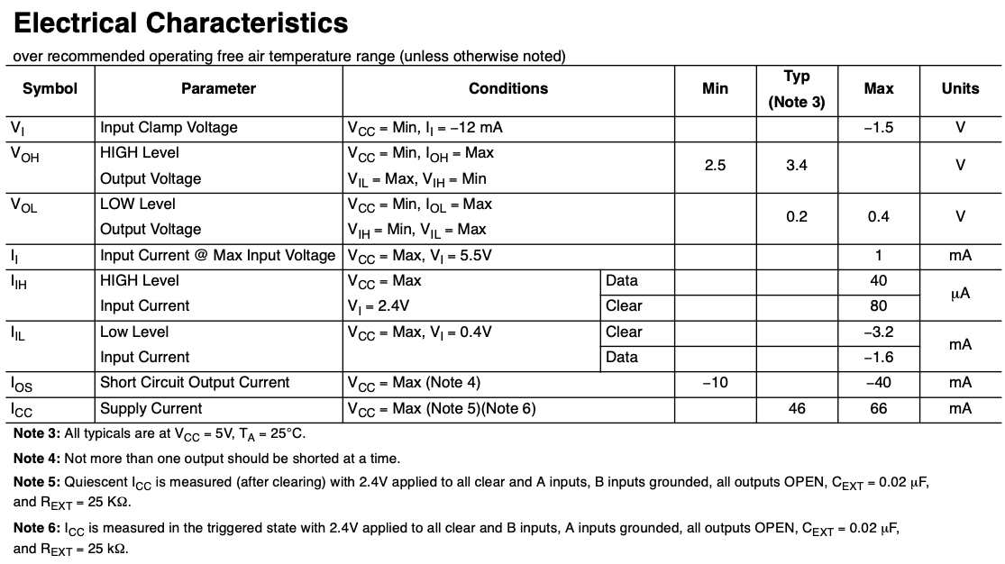
Debouncing 74123 – One Shot

Slide 12
Backup Slides

Slide 13
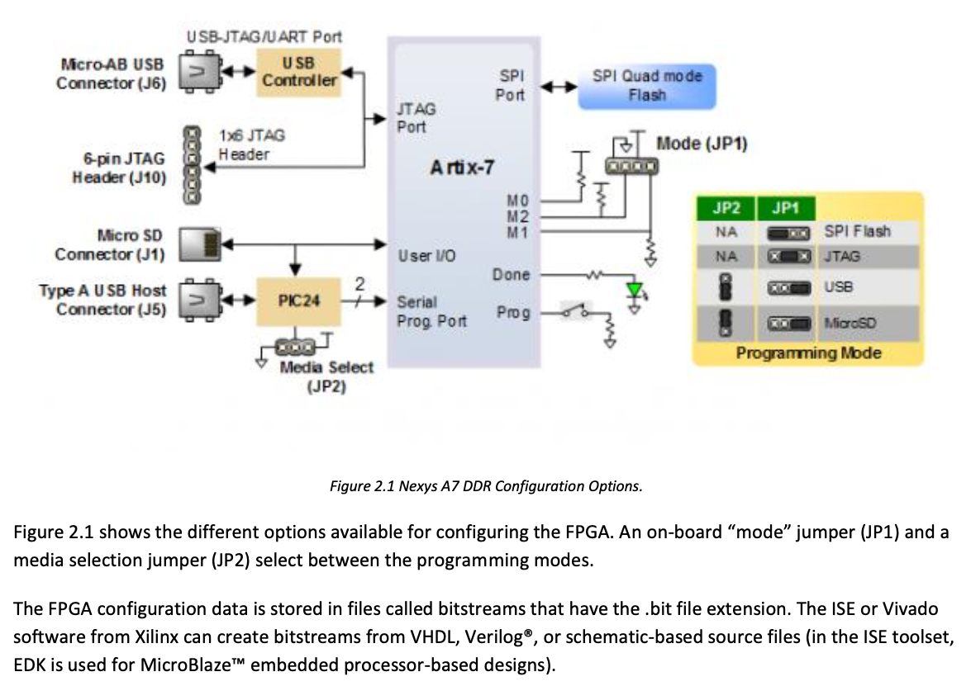
Programming the FPGA
13

Slide 14
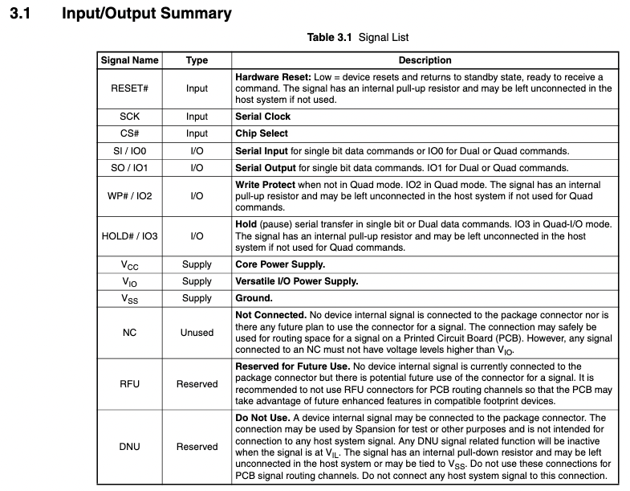
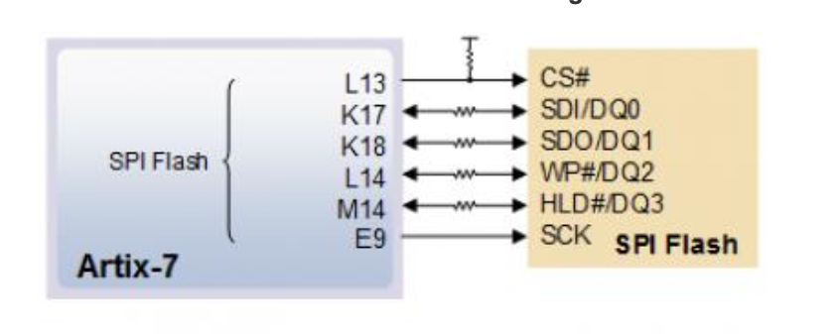

Programming the FPGA
14

Slide 15
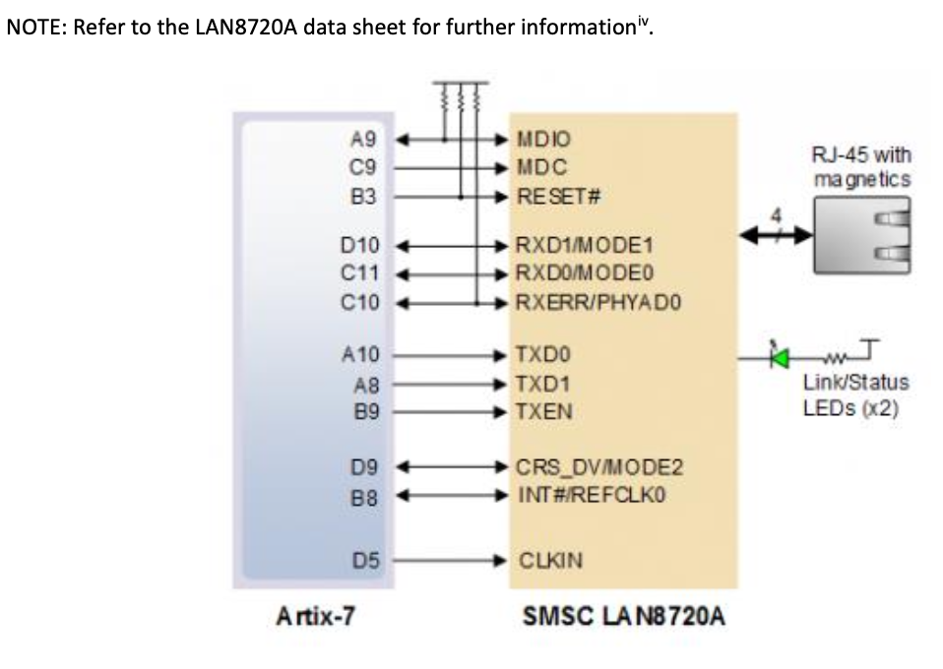
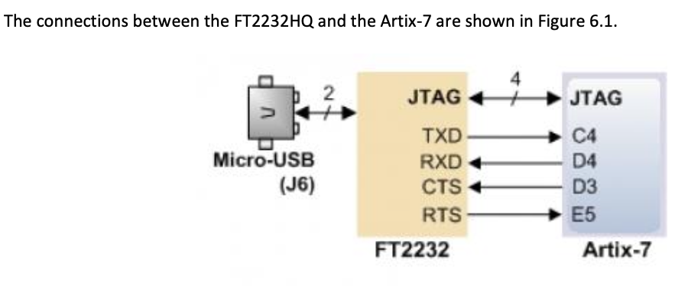
The FPGA Data Connection
15

